Slide 1
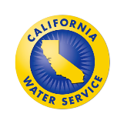
California Water Service
June 13, 2019
Quality. Service. Value.
C
CUEA Members Meeting the Challenge
2018- An Unprecedented Year for Wildland Fires
Water Utilities Lesson Learned
Gerald Simon, VP Safety, Security and Emergency Preparedness Officer

Slide 2
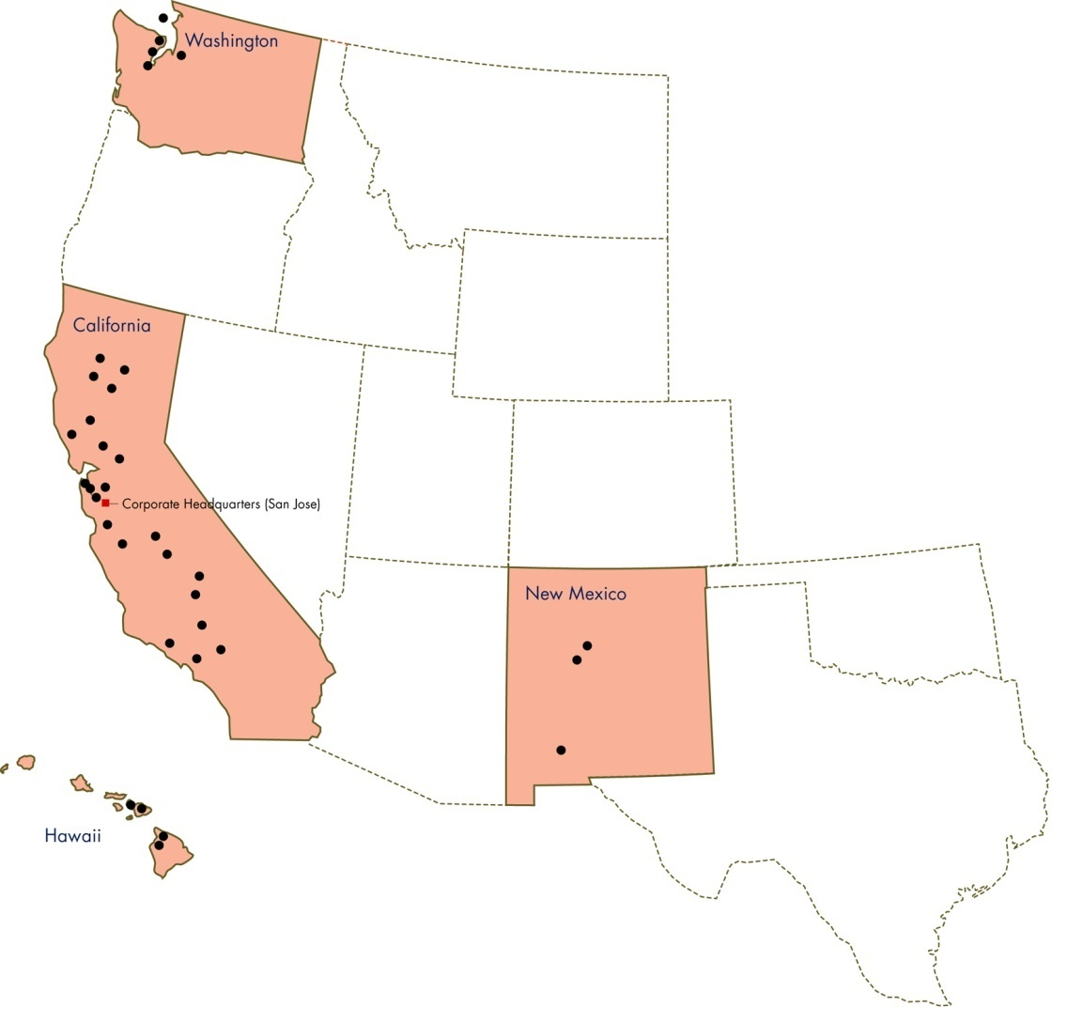
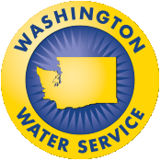
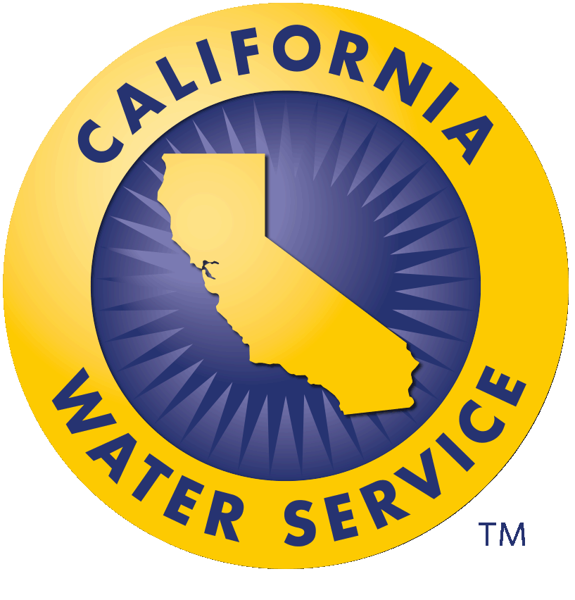
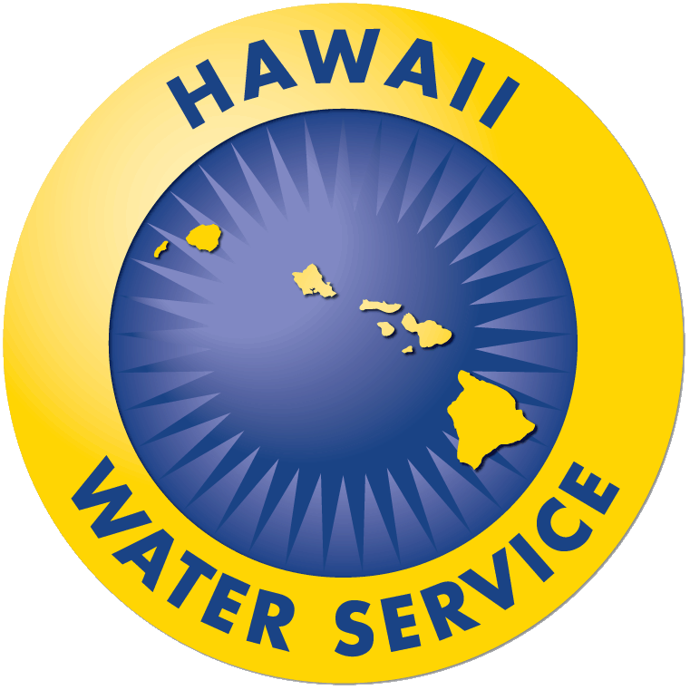
California Water Service Group
Largest in the West
3rd largest in U.S.
Serves 2 million+ people via…
6,000+ miles of main
1,130 wells
662 storage tanks
155,000+ valves
50,000+ hydrants
2,010+ sampling stations
6 surface water treatment plants
10 wastewater treatment plants

Slide 3
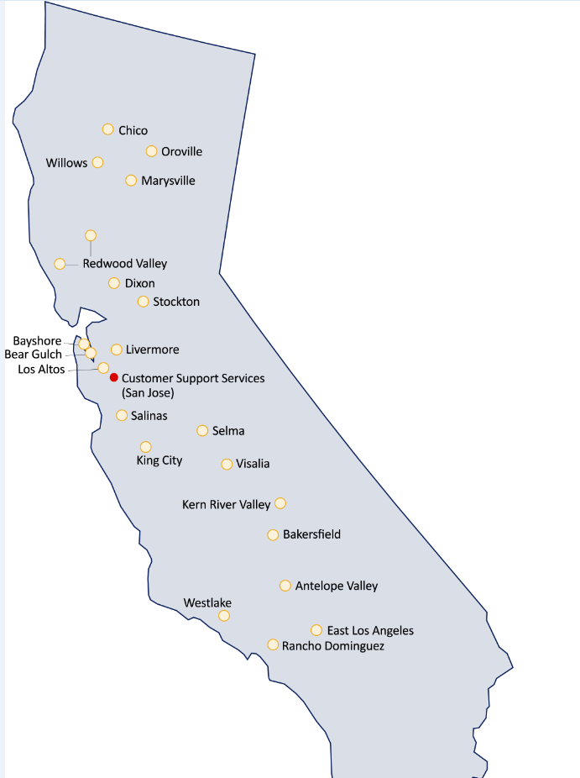
California
Regional Map
Corporate Headquarters –
Customer Support Services
22 Districts in California
San Jose, CA

Slide 4
National Response Framework
Recover
Prevent
Prepare
Respond
(mitigate)
Over the past 4 years, Cal Water has implemented a number of programs to do our part to adhere to our nation’s Response Framework.

Slide 5
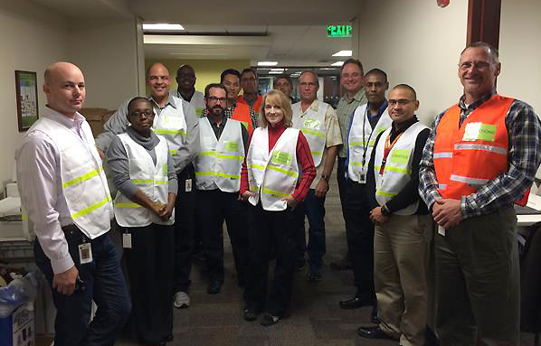
Cal Water’s Emergency Response Approach
Conduct emergency response/Emergency Operations Center (EOC) training for all managers, supervisors, and corporate officers
Train “Boots on the Ground”
Utilize our Emergency Action Guidebook, a response template for field & office employees

Slide 7
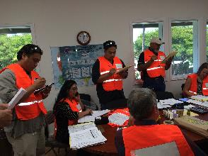
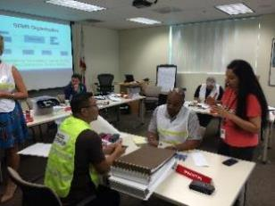
Emergency Operations Center Training
Annual emergency response training so each officer, supervisor, and manager aware of his/her position and role during EOC activation
All districts/subsidiaries, (16) 6-hour courses
Boots on the Ground training (12) 3-hour courses
Adherence to and compliance with National Incident Management System (NIMS), Standardized Emergency Management Systems (SEMS- state), and Incident Command System (recognized all-hazard response mitigation)
Establishment of EOC equipment in every district and subsidiary – “EOC in a Box”
Utilizes emergency “size-up” and field operations checklists to assure a coordinated response

Slide 8
5
4
3
2
1

Slide 9
EOC Activations
Since we launched our emergency response refresh four years ago, we have set up EOCs on 29 different occasions. Most notably, we have had 6 extended EOC activations, which have solidified our use and utilization of emergency response principles.
Major EOC activations include:
December 2014 statewide storms – EOC set up to support 21 California districts (2 days)
2016 Erskine Fire – 108 employees from 20 Cal Water districts (17 days)
2017 Oroville Spillway incident - EOC in Chico (5 days)
2018 Mendocino Complex Fire – EOC in Marysville for Lucerne (10 days)
2018 Woolsey Fire – EOC in Westlake (4 days)
2018 Camp (Paradise) Fire – EOC in Chico (10 days)

Slide 10
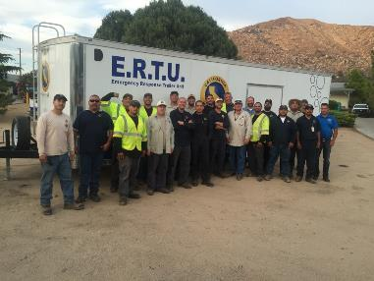
Emergency Response Trailer Unit
Fully equipped
Can sustain 6 workers with all tools, equipment, tents, port-a-potties, and cooking equipment for 7 days
Notes:
Tie to slide before where we talk about communication with state legislature outreach
Congressman Kevin McCarty – Chris existing relationship

Slide 11
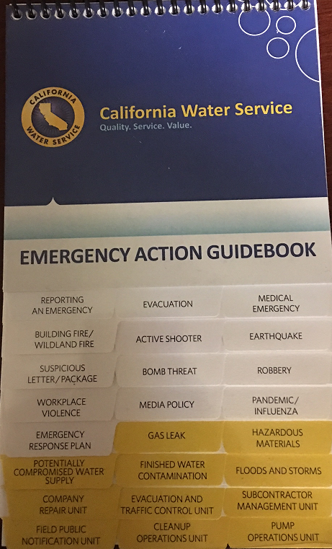
Emergency Action Guidebook
Step-by-step checklists for a number of emergencies, including:
Earthquakes
Active shooter
Water quality emergencies
Floods & storms
Given to EVERY Cal Water staff member (desks) and placed in every service vehicle (trucks) to utilize when these emergencies occur
Notes:
Tie to slide before where we talk about communication with state legislature outreach
Congressman Kevin McCarty – Chris existing relationship

Slide 12
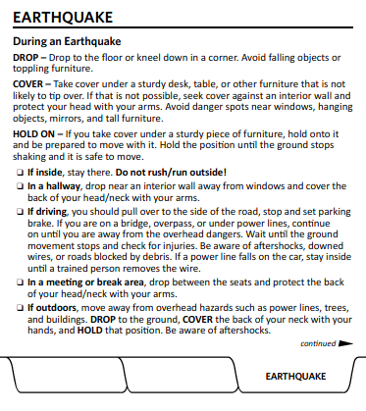
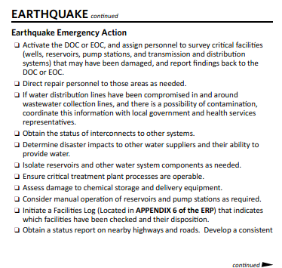
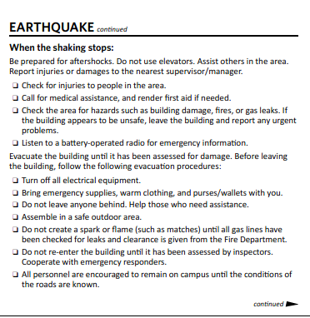
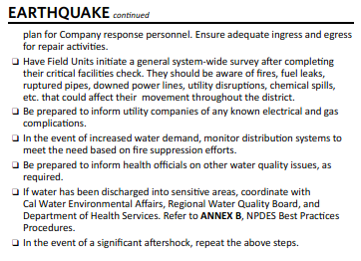
Earthquake Checklist (example)
Office Actions
Field Actions

Slide 13
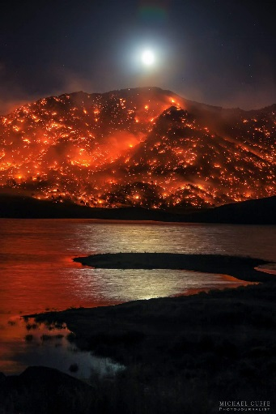
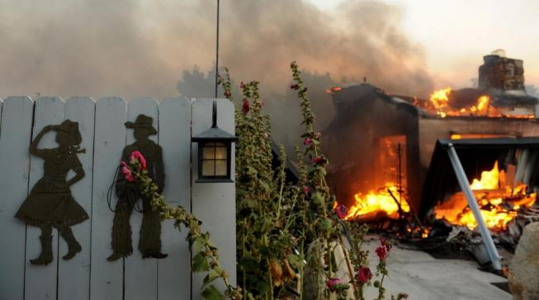
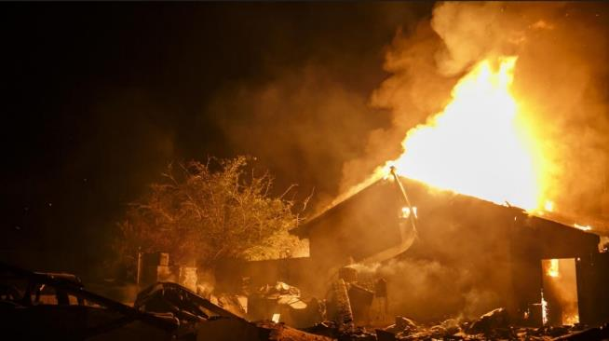
Erskine Fire (Kern River Valley)
Notes:
Happened between June 23 and June 24

Slide 14
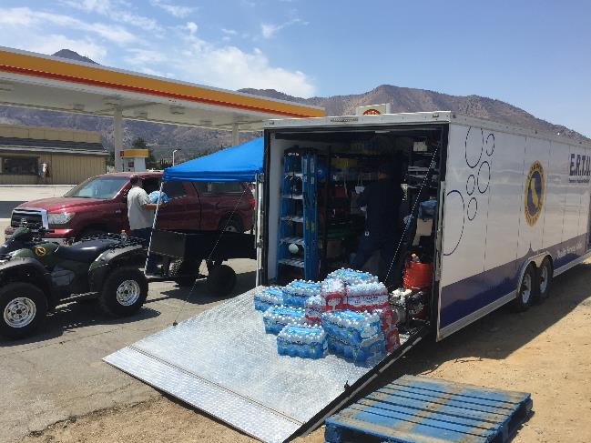
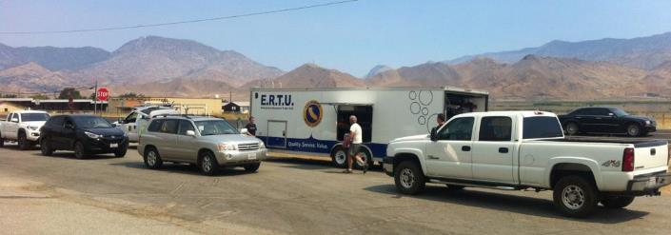
Erskine Fire: Coordination
108 people responded
14 districts sent personnel and equipment to assist
Extensive coordination with Cal Fire, Kern County, US Forest Service, and BLM
17 days of EOC activation, 13 of those handled in Bakersfield
Emergency Response Trailer Unit utilized to assist in this effort
Focused on our two emergency response missions
Provide water for firefighting
Provide clean, fresh water for our customers to drink
Received NAWC Living Water Award for Erskine Fire response

Slide 15
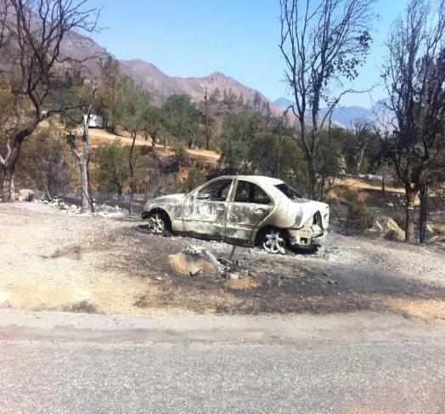
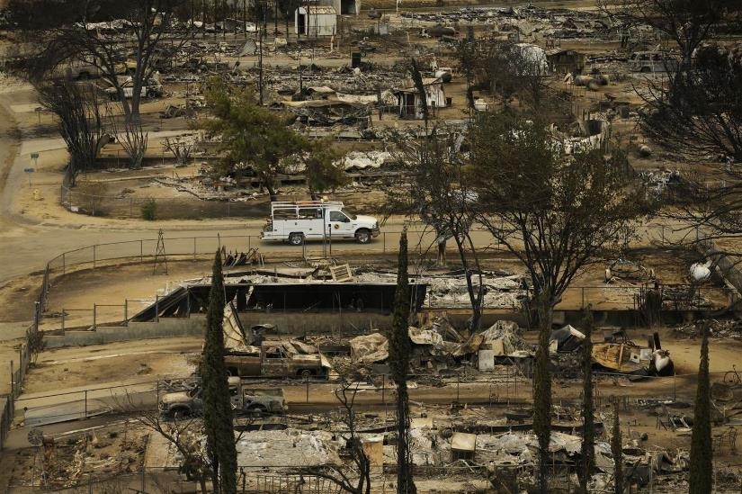
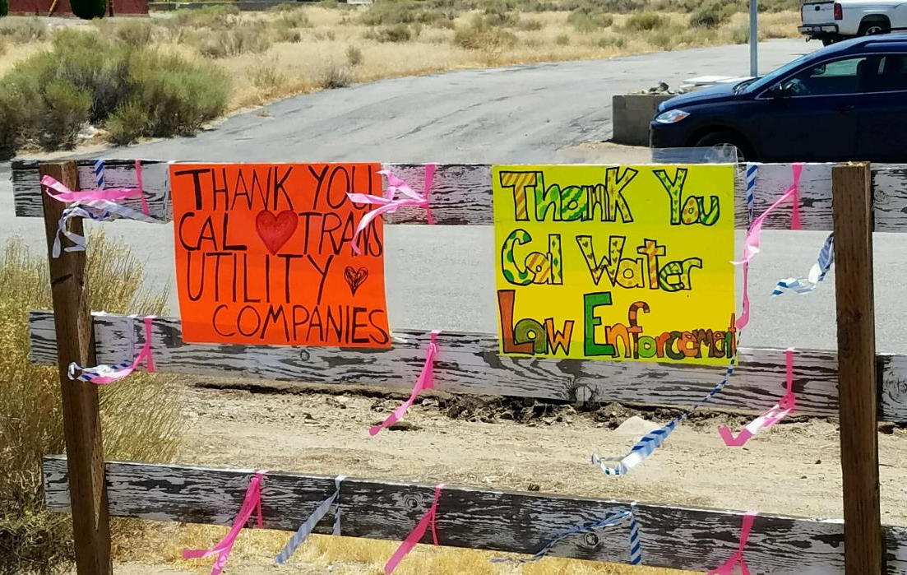
Erskine Fire: The Aftermath & Recovery

Slide 16
Lessons Learned
Make sure you can obtain fuel for generators & vehicle during wildfire operations
Local area impacted, so water for Community Points of Distribution (CPODs) may need to come from outside of the area
Keep ample CPOD inventory on ERTU
Because small districts don’t have enough resources in an emergency, they need help from other districts to support EOC
Consider multiple resources needed to keep system running (generators, fuel, EMTs)
Notes:
Gerald

Slide 17
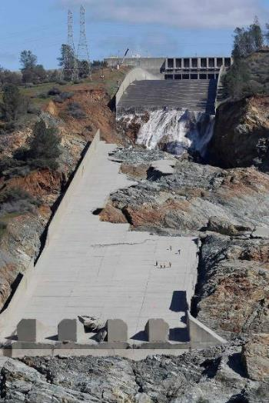
Oroville Spillway Incident

Slide 18
Oroville Spillway Incident
Caused evacuation of Marysville, Oroville, and Yuba City
Marysville & Oroville citizens evacuated to Chico Fairgrounds
Cal Water EOC established in Chico in support of Oroville & Marysville
Cal Water had to run pumps manually during evacuation
Our operations set up to protect our workers
Included checking with National Weather Service and continuing to know when we could go back to check water system and fill fuel tanks
Cal Water embedded in Butte County EOC to support firefighter operations and assure availability of water for firefighting
CPODs set up to deliver bottled water to our thousands of displaced residents
Cal Water provided movie night and See’s candy for Valentine’s Day
Extensive coordination with NOAA to save threatened steelhead fish

Slide 19
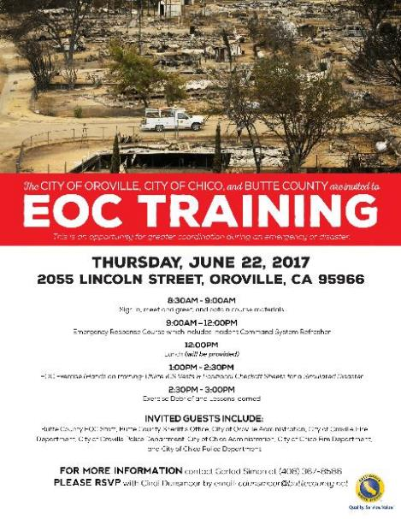
As a gesture of partnership and contribution to the community, Cal Water returned to Chico, Oroville, and Marysville to provide emergency response and EOC training for all three cities.

Slide 20
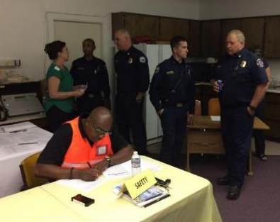
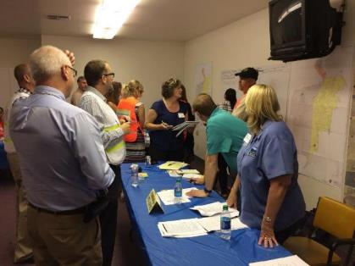
Oroville Community EOC

Slide 21
Lessons Learned
Obtaining water for CPODs essential
Corporate Communications partnership is essential in relaying evacuation and CPOD messaging
Partnership with weather service very important- critical in making strategic & operational decisions
Opening EOC is essential, even when local government may not
Putting system on generators only (with EMTs) also important; Systems may have to power on and be left without crews.
Make sure you consider fuel needs
Notes:
Gerald

Slide 22
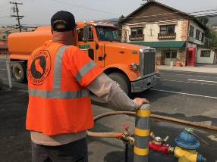
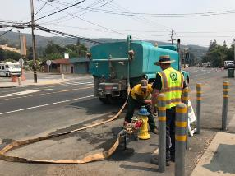
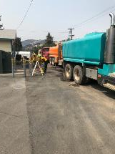
Mendocino Complex Fire (Lucerne)
Largest recorded fire in California’s history at 459,123 acres
Spanned Lake, Glenn, Colusa, and Mendocino counties
157 residences and 123 other structures destroyed
Directly impacted our Redwood Valley District’s Lucerne system (Clear Lake)
Must keep plant operating to provide critically needed water supply for firefighting
EOC established in Marysville to support Lucerne

Slide 23
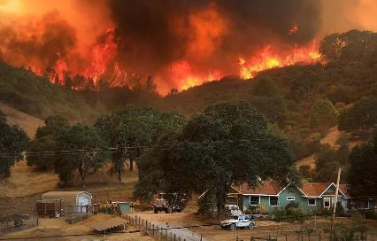
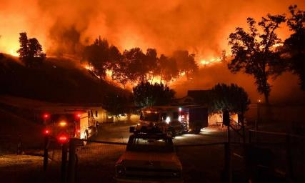
Mendocino Complex Fire

Slide 24
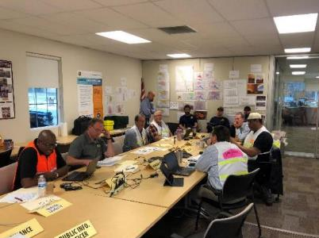
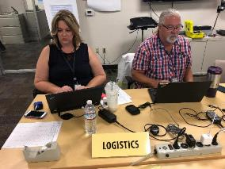
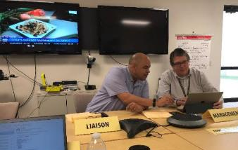
Mendocino Complex Fire: Marysville EOC

Slide 25
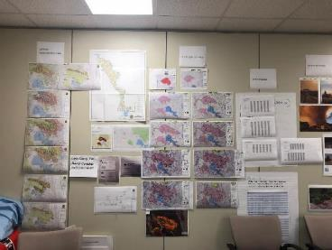
Mendocino Complex Fire: Planning, Situation Status, Accountability

Slide 26
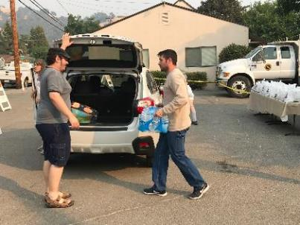
Mendocino Complex Fire: Recovery CPODs

Slide 27
Lessons Learned
Have and utilize remote SCADA capabilities
Consider alternatives when there may be personal crises during a company emergency
Know who essential responders are in first responder areas
Embed personnel with county EOC or SOC if required
Keep EOCs free of contaminants
Pre-event: establish fuel contact(s) and make sure you can calculate fuel needs and obtain fuel
Get engineering support
Notes:
Gerald

Slide 28
Woolsey Fire (Westlake District)
November 8-21, 2018
1,500 structures destroyed, 341 damaged, 96,949 acres burned
3 firefighter injuries, 3 civilian fatalities
Source: abc7news.com
Notes:
Gerald

Slide 29
Woolsey Fire (Westlake District)
Early activation of EOC needed
Texting not an effective form of communication at 3:30 a.m., integrated communication contemplated with 24-hour Call Center
Wind events and impending PSPS should prompt district personnel to top off tanks and vehicles
Ongoing relationships with local fire, police, and politicians essential
Source: latimes.com
Notes:
Gerald

Slide 30
Lessons Learned
Must be able to coordinate with public agencies
Use hydraulic models for water demand, impact, and water quality analysis
Utilize GIS and mapping abilities to visually indicate situational awareness to diverse set of stakeholders
Have SCADA operational awareness of asset status, levels, and water supply; ensure alerts are set and functional
Identify hydrants and relay volume for fire supply to supporting agencies
Know that Engineering can support other roles and vice versa (ex. mapping and relief incident commander)
Notes:
Use of hydraulic models are important for both water demand and impact
Availability & Resiliency
Water Quality
GIS and Mapping provide a means to visually indicate situational awareness
SCADA operational awareness of asset status, levels, and water supply
Engineering can provide other roles:
Supply chain for recovery, parts, and asset components
Support WQ evaluations and treatment processes
Field activities and evaluation

Slide 31
Camp Fire (Paradise/Chico)
November 8-25, 2018
Structures destroyed:
13,972 residences
528 commercial
4,293 other
88 civilian fatalities, 3 firefighter injuries
153,336 acres burned
Became most destructive loss of life fire in the state’s history
Notes:
Mike

Slide 32
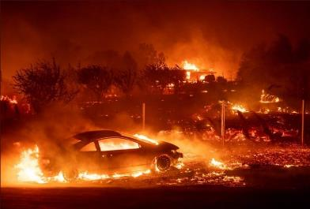
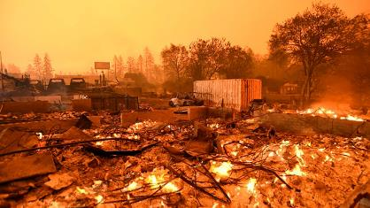
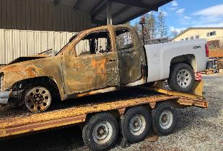
Camp Fire (Paradise/Chico)
Source: abcnews.go.com
Source: sanfrancisco.cbslocal.com
Notes:
Mike

Slide 33
Lessons Learned
Evacuate in a timely manner
Protect employees from excessive smoke; keep air filters, N95 masks, and other essential supplies available
Determine short-term and extended mutual assistance and personnel needs for that
Critical Incident Response Management (CIRM) peer to peer support program is an extremely critical resource during and after the disaster
Notes:
Gerald

Slide 34
Coordination with PIO/Liaison is Key

Slide 35
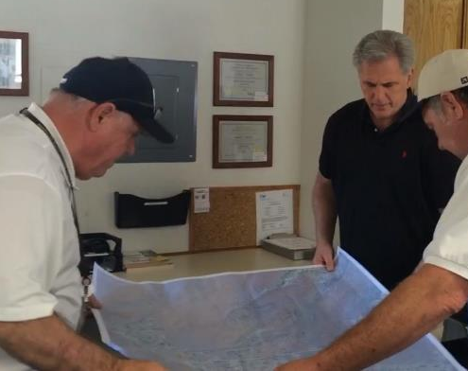
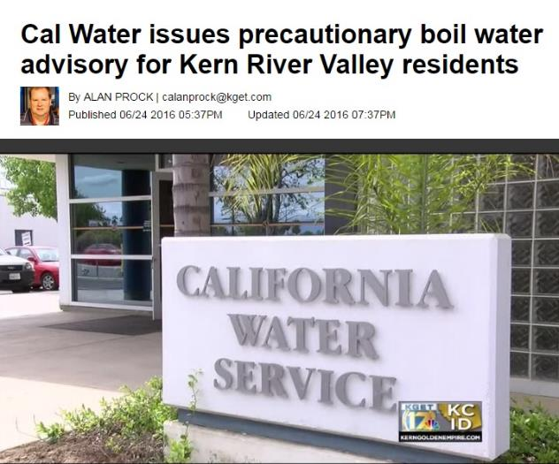
PIO/Liaison
Communication for water quality issues, system concerns, community support
Door-to-door, email, text, phone communication with customers
Regular updates to city, county, community leaders and media
Updates to legislators and PUC
Dedicated section on web site home page
Frequent updates on social media
Participation in community meetings with first responders and residents

Slide 36
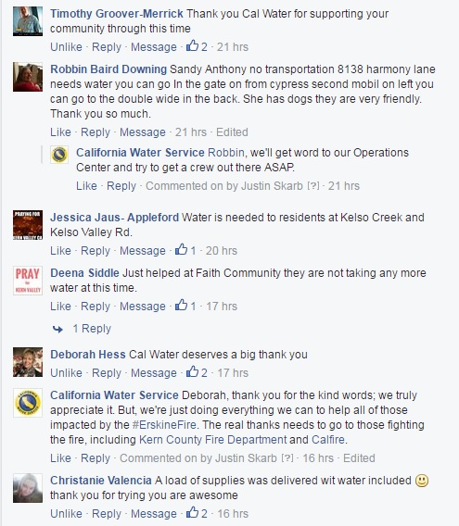
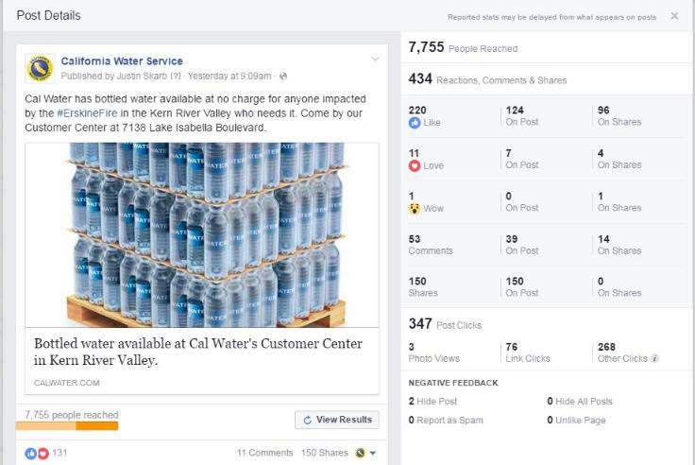
Social Media Engagement
Significance of highlighted comment: This customer had been very outspoken critic of Cal Water due to water rates

Slide 37
Communication Lessons Learned
Regular, proactive, direct communication important to quell fears, enhance confidence in our ability to serve
Must build relationships to maintain ability to coordinate with public agencies (state, county, and local)
Customers receive information via various channels, so must use comprehensive outreach approach
Steps to support community (CPODs, distribution centers) help build relationships
Notes:
Gerald

Slide 38
Focusing on Recovery:
Critical Incident Response Management (CIRM)
Emotional wellness and peer support provided to employees who respond to, or are affected by, disasters or traumatic events
54 Cal Water employees currently trained to provide emotional support following an incident or response
CIRM team utilized 18 times during the past 2½ years

Slide 39
Community EOC’s
Implement Community EOC programs in small districts and rural areas
Small areas must work together as resources may have extended response times

Slide 40
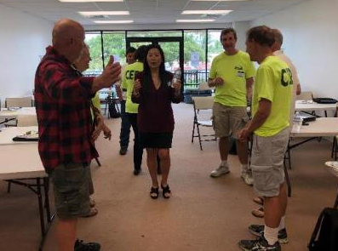
Hawaii Community EOC
53 community members attended, including Hawaii PUC Commissioner Lorraine Akiba

Slide 41
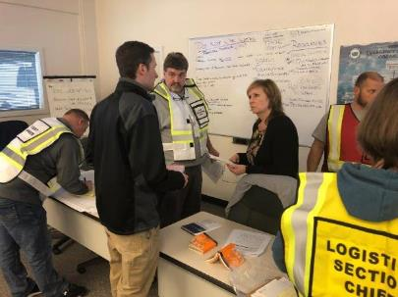
Washington Community EOC

Slide 42
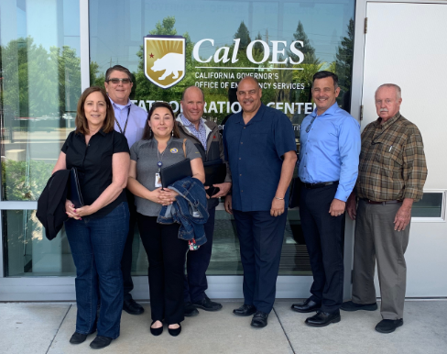
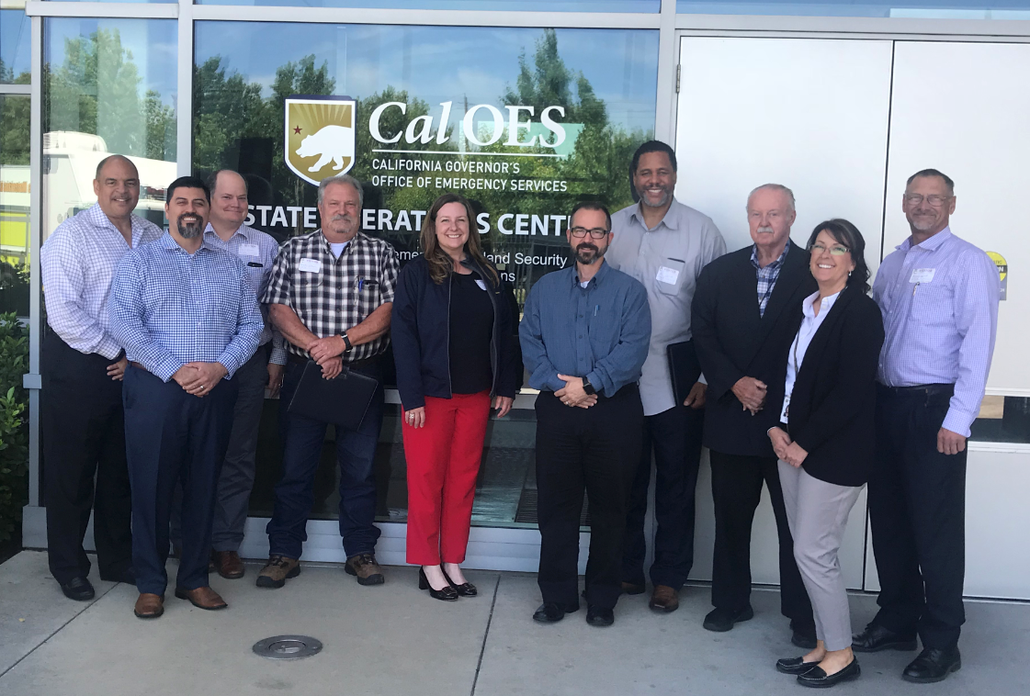
Lessons Learned
Address vulnerabilities and assess potentially under-resourced areas
Ensure equipment and assets, including transfer switches, are in proper working order or repaired/ replaced
Maintain ability to coordinate with public agencies (state, county & local)
Address statewide concerns – we must partner on vegetation management strategies (raking the forests
Notes:
Gerald

Slide 43
Lessons Learned
Over-prepare with personnel, generators, etc.
Assure continuous water quality support during critical incidents
Must keep water flowing for firefighter use and customers health
…fuel for generators and vehicles…
…filters for office and employee safety.
Notes:
Gerald

Slide 44
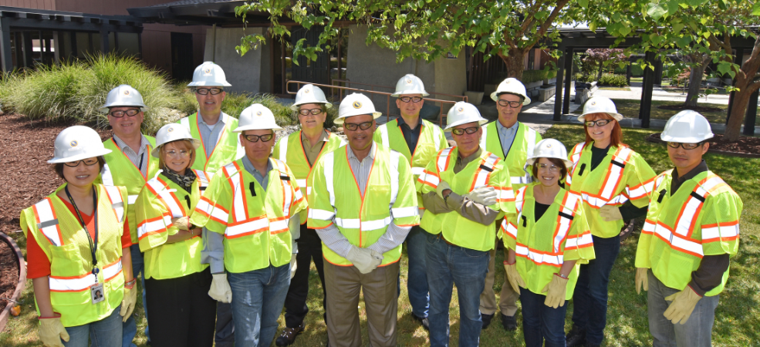
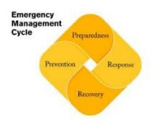
It works well when
Prevention, Preparation, Response & Recovery
are ALL utilized…

Slide 45
Q&A
Thank You!
Quality. Service. Value.

