Slide 1
EEI’s Wildfire Initiative
California Utilities Emergency Association (CUEA)
Chris Eisenbrey
Senior Director, Preparedness & Recovery Policy
Edison Electric Institute (EEI)
Notes:
Thank Don Boland and PG&E for inviting me to this discussion.
Learned a lot today: ????
Last speaker of the day
Here to present and discuss
EEI Wildfires Initiative / CEOs
Give you and industry-level perspective and
Most importantly learn for the experts assembled in this room and explore partnership opportunities with CUEA if the group is interested.
We can certainly try to help from Washington, DC, but we recognize the real action is happening on the ground in the states.

Slide 2
About EEI
The association that represents all U.S. investor-owned electric companies. Our members provide electricity for about 220 million Americans, and operate in all 50 states and the District of Columbia.
As a whole, the electric power industry supports more than 7 million jobs in communities across the United States. In addition to our U.S. members, EEI has more than 65 international electric companies, with operations in more than 90 countries, as International Members, and hundreds of industry suppliers and related organizations as Associate Members.
Organized in 1933, EEI provides public policy leadership, strategic business intelligence, and essential conferences and forums.
Notes:
First a little about EEI
Based in DC, 7 blocks west of Capitol Hill and 9 blocks east of the White House
Advocacy and public policy representative of the investor-owned electric utilities. We represent three companies in this room, SCE, PG&E and SDG&E.
We are run by a Board of Directors which is made up of all our member company CEOS
My group…
The next five slides will be common-knowledge for most if not all of you, but I think it is important that I share with you the messages and the context we are providing to the many stakeholders, policymakers, and partners in DC and around the nation

Slide 3
Wildfire Risk in Context
Total 2018 wildfire costs in California approach $24.2B - a new U.S. record
The 2018 Camp Fire accounted for ¼ of all monetary damages from U.S. billion-dollar disasters
The last 2 years of U.S. wildfire damage has been unprecedented, with losses exceeding $40.B
In 2018, over 8.7 million acres burned across the U.S.
Wildfire season is generally longer in duration than the past
Notes:
First the context for this discussion
Stats are from NOAA’s National Centers for Environmental Information
What we are seeing is enormous financial impacts and destruction over a longer time period.
In 2018, over 8.7 million acres burned across the U.S.
Well above the 10-year average (2009-2018) of 6.8 million acres
According to the California Department of Forestry and Fire Protection, the state’s wildfire season is now 78 days longer than it was more than a generation ago.

Slide 4
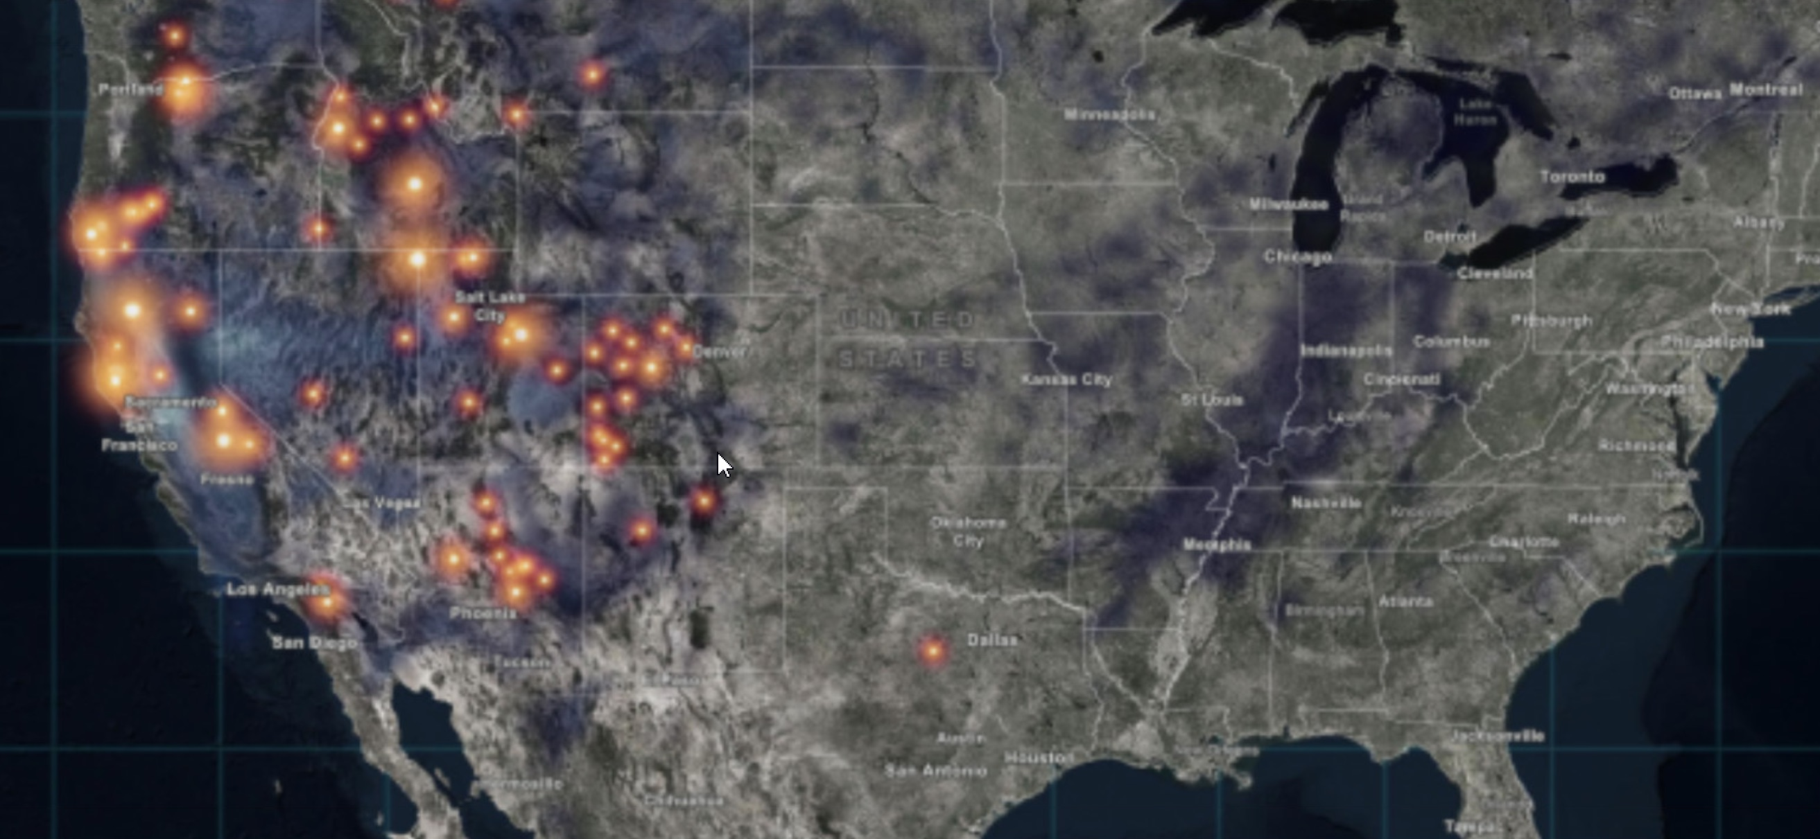
Wildfires and Climate Change August 6, 2018
August 6, 2018
NOAA National Centers for Environmental Information (NCEI) https://www.ncdc.noaa.gov/billions/
Notes:
When the risks are combined with climate change again we are seeing longer and more destructive wildfire seasons
As you can see from the map, this is not just a problem in California.

Slide 5
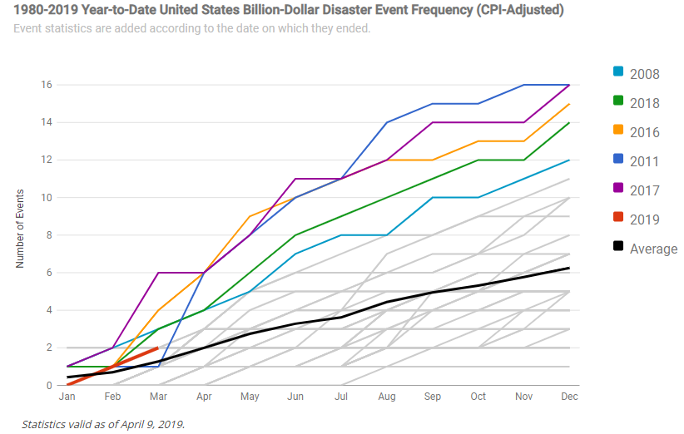
Number of Billion Dollar Weather and Climate Disasters
NOAA National Centers for Environmental Information (NCEI) https://www.ncdc.noaa.gov/billions/
Notes:
Greater frequency of destructive events and increasing cost per event

Slide 6
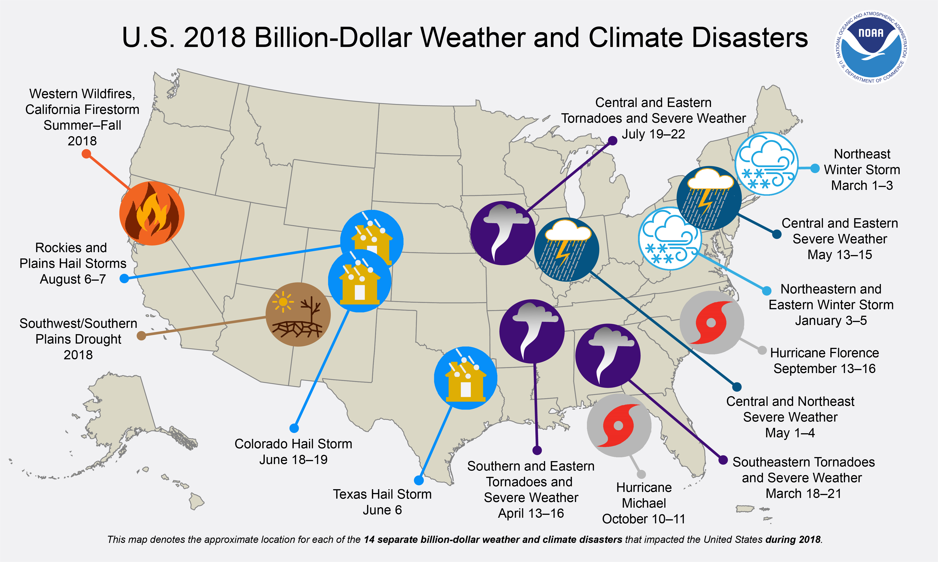
2018: Active Year of Billion Dollar Weather and Climate Disasters
NOAA National Centers for Environmental Information (NCEI) https://www.ncdc.noaa.gov/billions/
Notes:
In 2018, there were 14 separate billion-dollar weather and climate disaster events across the United States, with a total cost of $91 billion.
The total cost over the last 3 years (2016-2018) exceeds $450 billion — averaging $150 billion / year.
The total cost over the last 5 years (2014-2018) is approximately $500 billion— averaging $100 billion / year.

Slide 7
Wildfire Risks are Increasing
Hot, arid conditions and dry vegetation (climate)
Significantly compromised tree and forest health
Invasive species (e.g., cheatgrass)
More development in the “WUI”
  Human-caused ignitions
  Larger losses
State and government programs that subsidize/encourage (re)development
Federal fire funding challenges
Under insurance; failure of insurance to appropriately reflect increased risks
Houses in the WUI by state; California Department of Insurance. http://www.insurance.ca.gov/0400-news/0100-press-releases/2018/upload/nr002-2018AvailabilityandAffordabilityofWildfireCoverage.pdf
Notes:
Why are the Risks increasing and the situation so dire?
Increased duration and severity of fire seasons exacerbated by climate change
We are also seeing a decrease in firefighting workforce
Reduced resilience of the landscape again exacerbated by climate change
Increase in development in the WUI (Wildland Urban Interface)
Federal fire funding challenges

Slide 8
EEI’s Wildfire Initiative
Kicked off at September 2018 EEI CEO and Board Session in Colorado Springs, CO on EEI’s “Two-Part Strategy”
  Suggested / best / shared practices; and
  Partnerships
Dialogue continued at January 2019 EEI Western CEO meeting and a keynote panel discussion at March EEI CEO and Board meeting
Notes:
Now that the context has been provided:
In 2018 EEI started the a CEO-led Wildfire Initiative to identify practices and potential partnership opportunities.
Effort co-led by Maria Pope, President and CEO, Portland General Electric and Darrel Anderson, President and CEO, Idaho Power.
Our member CEOs meet quarterly and since the September meeting this topic and the initiative have been front and center at those discussions.
Just this week at the June CEO meetings in Philadelphia….an executive-level panel or as we call it a “Learning Track” was held focused on the increasing frequency and intensity of wildfires, hurricanes, and other extreme weather events and how they are testing the resilience of electric companies and impacting their customers.
Takeaways: Mitigating and recovering from these events demand greater investment and new tools to manage these risks.
Takeaways: As customers, regulators, and investors look on, electric companies are exploring new technologies, partnerships, and risk mitigation tools.
DON’T READ THE PANEL NAMES, for Q&A
Rob D'Arienzo, senior meteorologist and global strategy leader for IBM
Darrel Anderson, president and CEO, Idaho Power.
Ronald Brisé, government affairs consultant for Gunster (and former commissioner of the Florida Public Service Commission);
Barnie Gyant, deputy regional forester, U.S. Forest Service; and
Margaret Peloso, liability risks and insurance expert from Vinson & Elkins.

Slide 9
EEI Wildfire Workshop
Hosted by Portland General Electric on April 26, 2019
  Member company wildfire management plans
  CEO perspectives on meeting the wildfire challenge
  Fire prevention, detection and suppression technology
  State, local and key partnerships
  Vegetation management and accessing rights of way
  Emerging issues
Key Takeaways
  Labor shortage around vegetation management
  Non-California electric companies looking for a better understanding on how to start the risk assessment for their systems or territories
Notes:
Following the January CEO meetings, EEI convened a workshop of EEI member company wildfire leads and key allied stakeholders to catalogue existing wildfire practices, assess emerging practices and issues, and discuss next steps

Slide 10
What is EEI Doing to Implement the Two-Part Industry Strategy?
Legal and Liability
Regulatory
The Administration and U.S. Congress
Public-Private Partnerships
Mutual Assistance
EEI Member Company Wildfire “Toolkit”
Notes:
So What is EEI Doing to Implement the Two-Part Industry Strategy that was initiated last September?
Legal and Liability
EEI General Counsel working with EEI member company legal staff are focusing on the concept of “inverse condemnation”. On counsel’s advice, I’ll just leave it at that since this issue is very complex and our strategy around it is still taking shape.
Regulatory
Focus is on Rights of Ways and Vegetation Management
The Administration and U.S. Congress
Recent Executive Orders coming out of the White House and in Congress: a vegetation management pilot program was passed as part of last year’s Farm bill.
Public-Private Partnerships
Federal Govt agencies: DOI, DOE, USFS, etc.
Electricity Sub-sector Coordinating Council
Mutual Assistance
EEI Member Company Wildfire “Toolkit”
Platform for sharing information among our membership
The White House responded by issuing a pair of Executive Orders. The first in January directed DOI and the Department of Agriculture, to among other things, develop a wildfire strategy plan by the end of 2020. We will continue our engagement with these agencies as they develop these plans.
Just a few weeks ago, a second Executive Order directing DOI and the Department of Commerce to act on the renewal and reauthorization of rights-of-way; a key issue we have been working on for a number of years.
The agencies have likewise responded. In January, DOI issued a Secretarial Order, and recently we have seen an increase in the renewal of rights-of-way authorizations and special use permits. The key going forward will be whether the direction from DC trickles down to the state and local federal land managers.
Looking to form a more permanent coordinating effort between the industry and our federal and state partners, we are looking to establish an ESCC like model for wildfires. There already exists a government-led wildfire leadership council and we are examining ways to have industry plug into that effort.
Turning to next steps, as I mentioned we will continue to work with DOI, the Department of Agriculture, and the Department of Commerce as they implement the Executive Orders. We will continue to engage the Department of Energy National Labs around technology development to assist in our effort. We will also be reaching out to the state and local firefighting agencies and other stakeholders to identify partnership opportunities. We will also have a subset of CEOs meet with the heads of the key federal agencies.
Internal to the industry, we have been engaging in meetings around industry practices, most recently last month at PGE, which was attended by some of your staff. We have leveraged the existing mutual assistance framework to help in response to a wildfire event.
We have developed a set of resources for member company use; the “wildfire toolkit”. One of the key items in the toolkit is a compendium of member company wildfire mitigation plans. For those companies that are looking at preparing their own plans, I would direct you to take a look at what our California company’s filed earlier this year.

Slide 11
Increased Risk + Larger Losses:
Who Pays?
Obligation to serve requires T&D lines in high risk areas
Electrical equipment involved in ignition of wildfires
Electric company liability for third-party losses
Notes:
Inverse condemnation: This is the basic equation we are working with our members on changing.

Slide 12
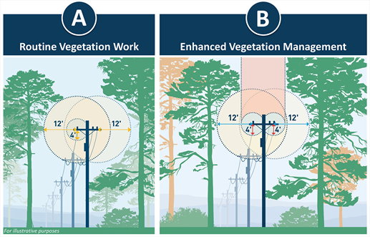
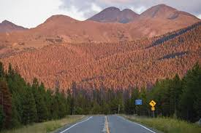
EEI is Working on Regulatory Approaches to:
  Ensure access to ROWs on federal lands
    USFS Master Special Use Permits
  Perform expanded vegetation management
    Adequate width, clearances and access for T&D
Employ pilot programs off-ROWs
  Sec. 8630 Utility Infrastructure Rights-of-Way Vegetation Management Pilot Program
    Address hazard trees
    Reduce fuel load
    Improve forest health
Photo courtesy of PG&E
Pine Bark Beetle Infestation in Colorado; Photo courtesy of High Country News
Notes:
Notes: possible vehicles-SO, MOU, Master agreements, include this type of work in new and renewed permits
USFS Master Special Use Permits
Addresses backlog of expired permits
O&M activities not explicitly authorized requiring USFS review
Looking for DOI to develop similar vehicle
SEC. 8630 Utility Infrastructure Rights-of-Way Vegetation Management Pilot Program
Allows utilities, at their own expense, to go off-ROW [Forest Service lands only] to remove dead and dying vegetation
Part of 2018 Farm Bill-Xcel’s idea to address pine bark beetle epidemic and resulting tree mortality in National Forests

Slide 13
Current Administration Efforts
EO 13855: Promoting Active Management of America’s Forests, Rangelands, and other Federal Lands to Improve Conditions and Reduce Wildfire Risk
S.O. 3372: Reducing Wildfire Risks on DOI Land through Active Management
EO 13868: Promoting Energy Infrastructure and Economic Growth
  (Sec. 6. Rights-of-Way Renewals or Reauthorizations)
Combined objective of these policies is to improve forest health through public-private partnerships:
  Kickstarts ROW renewals/reauthorizations using master agreements
  Enhances vegetation management
  Incorporates O&M into land-use authorizations
Notes:
Combined objective of these three policies is to improve forest health through public-private partnerships:
Kickstarts ROW renewals/reauthorizations using master agreements
Enhances vegetation management
Incorporates O&M into land-use authorizations

Slide 14





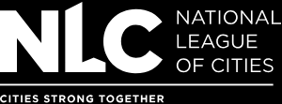

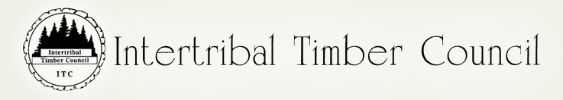



Public-Private Partnerships
  Goal is to increase prevention and, detection and response capabilities
  Reaching out to key stakeholders
    WGA, enviros, feds and states
  ESCC model for wildfires
    Wildland Fire Leadership Council (WFLC)
    Western Forestry Leadership Coalition (WFLC)
???
Notes:
Notes: Build on collaborative model and existing fed-state-local response
WFLC Members: DOI, DoD, FS, DHS-FEMA, NGA, NACo, National League of Cities, Intertribal Timber Council, IAFC, NASF
I wanted to talk for a few minutes about the partnerships that EEI has been cultivating in the wildfire space. We have been meeting extensively with the White House, the Department of the Interior, Department of Agriculture and the Department of Energy to discuss ways that we can work together to prevent, detect and, when necessary, suppress wildfires.
ESCC policy coordination with WFLC:
WFLC is an intergovernmental committee of Feds, state, tribal, county and municipal governments officials convened by the Secretaries of Ag, Interior, Defense and Homeland Security
Dedicated to consistent implementation of wildfire policies, goals and management activities
Provides strategic oversight to ensure policy coordination, accountability and implementation of long-term strategies

Slide 15
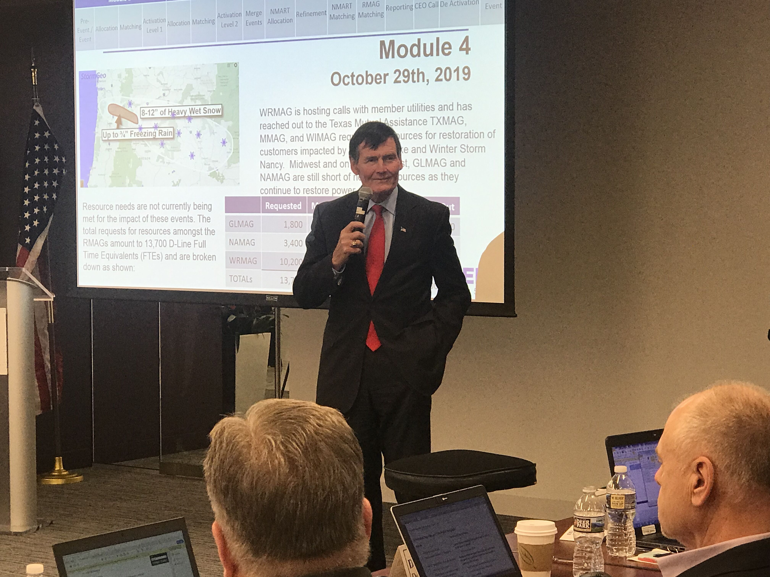
Mutual Assistance Framework
Mutual Assistance
  Companies throughout the West have traditionally provided mutual assistance in support of wildfire power outages
  Camp Fire-1st time use of EEI’s national mutual assistance framework in response to a wildfire event
National Response Event (NRE)
  In the case of an NRE activation, EEI’s mutual assistance program will be scaled to a national level so member restoration resources are allocated in a singular and seamless fashion
EEI 2019 NRE Tabletop Exercise
Notes:
During the Camp Fire, EEI's national mutual assistance framework was used to provide a forum for Pacific Gas & Electric to make resource requests and obtain support from companies across the country.
What is an industry-wide National Response Event? The most serious outage events are classified by EEI members as “national response events” (NREs). An NRE is a natural or man-made event that causes or is forecast to cause widespread power outages impacting a significant population or several regions across the U.S. and requires resources from multiple RMAGs

Slide 16
EEI Member Company “Toolkit”
Suggested practices and training
Appropriate federal/state/local linkages
Legal frameworks
Insurance
Fire suppression
Technology development & deployment
Mutual assistance
Expanded vegetation management
Comprehensive mitigation plans
Other specific targets – e.g. wildfire risk ROE
Notes:
Online and secure platform for EEI Member to Member information and suggested practices sharing

Slide 17
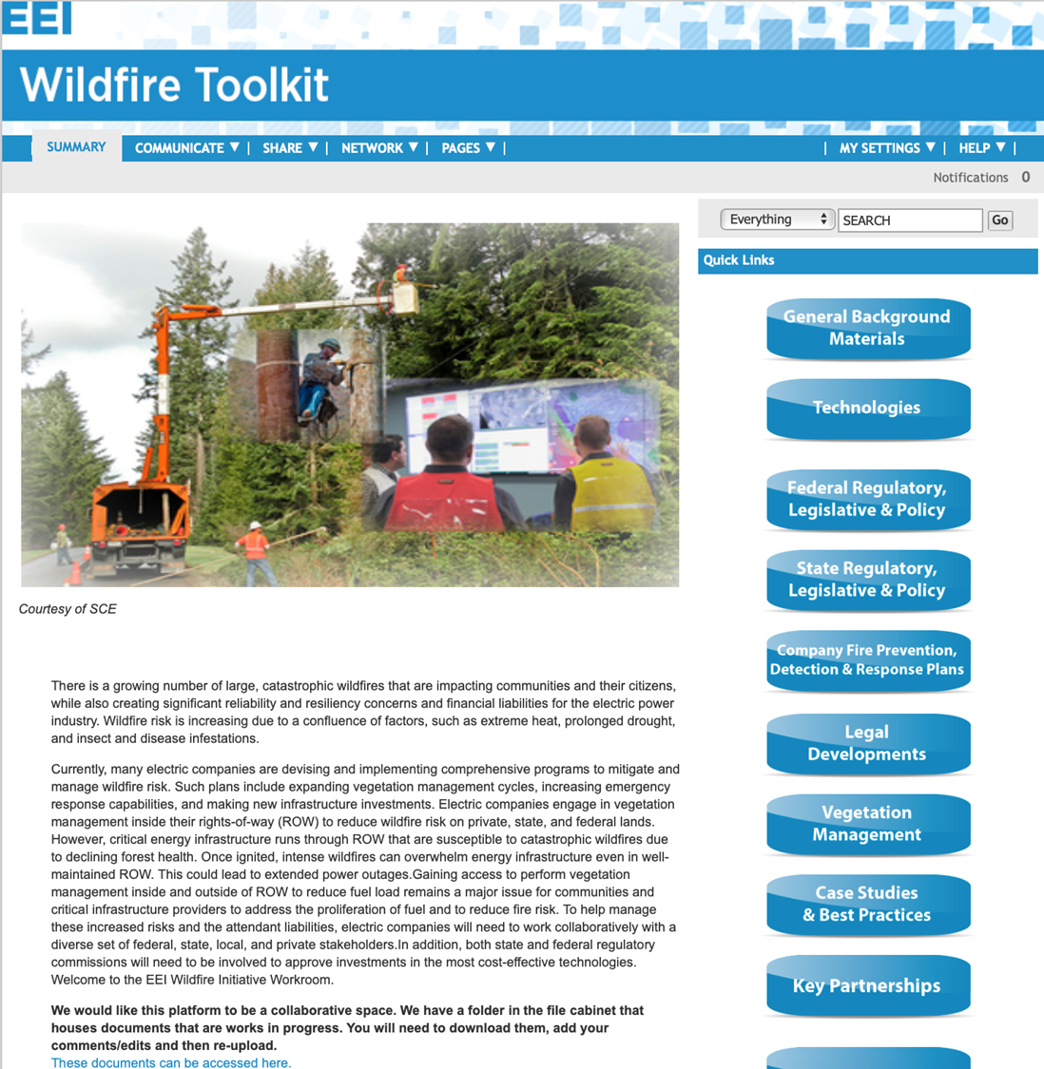
Review: EEI CEOs Are Focused
Maintains a shared interest in how federal permitting and siting issues affect overall wildfire mitigation and response efforts
  CEO Wildfire Initiative
    Cross-cutting staff level effort engaging variety of disciplines
  EEI Wildfire Toolkit
  EEI Wildfire Workshop-April 26th
  Company Board-level Education
  CEO fly-in: WH/DOI/USFS
  Financial Community Outreach
  Governors and PUCs
  Company-specific wildfire plans
Notes:
As an overview:
EEI and our board of directors are focused on the wildfire space.
CEO led EEI Wildfire Initiative
The EEI Member Wildfire Toolkit
Workshops
CEO fly-ins (planning one as we speak for late July)
Engaging governors and PUCs
Suggested practices sharing of plans etc.

Slide 18
Q&A / Contact Information

