Slide 1

California Fuel Overview & Emergency Fuels Activities
CUEA Annual Conference
South Lake Tahoe
June 13, 2019
Gordon Schremp
California Energy Commission
gordon.schremp@energy.ca.gov 916-654-4887
California Energy Commission

Slide 2
Transportation Fuel Supply - Overview
California Energy Commission

Slide 3
California On-road Transportation Fuels
  15.47 billion gallons of gasoline consumed in 2018
  2018 drop in consumption first decline since 2012 – is this possibly peak gasoline demand in California?
  Base gasoline demand up 6.4 percent between 2012 and 2018
    Ethanol use increasing due to Renewable Fuel Standard
    Ethanol use up to a record 1.60 billion gallons during 2018
    172 percent increase since 2003
    Ethanol accounted for 10.35 percent of total gasoline gallon during 2018
California Energy Commission

Slide 4
California On-road Transportation Fuels
  3.73 billion gallons diesel consumed during 2018
  Base diesel fuel demand 3.3 percent decline between 2012 and 2018
    Biodiesel use increasing due to Renewable Fuel Standard and the Low Carbon Fuel Standard (LCFS)
      184 MM gallons during 2018
    Renewable diesel fuel use up to 384 MM gallons during 2018 due to LCFS
    Combined renewable component accounted for 15.2 percent of total diesel gallon
California Energy Commission

Slide 5
Transportation Fuel Infrastructure
  The California transportation fuel “infrastructure” consists of several interconnected assets operated by a combination of refiner and third-party companies
    Refineries
    Marine terminals
    Pipelines
    Storage tanks
    Rail
  Crude oil and petroleum product infrastructure assets are separate and distinct from one another – not interchangeable
  Unlike with the electricity distribution system, Northern California is not directly connected to Southern California by petroleum product pipeline
California Energy Commission

Slide 6
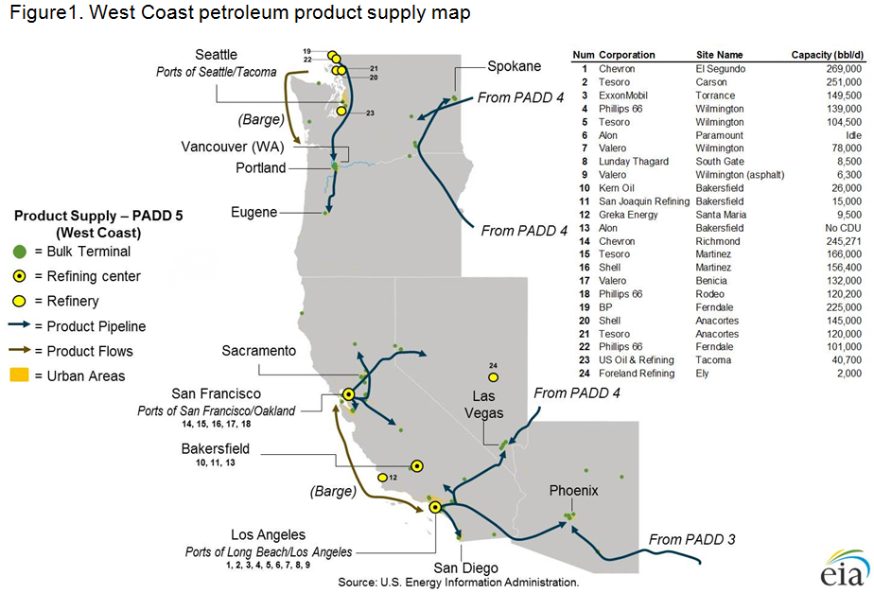
Western States More Isolated than Rest of U.S.
California Energy Commission

Slide 7
California Fuels Market - Isolated
California’s fuel market is nearly self-sufficient, so supplies of gasoline & diesel fuel from outside of California are not routinely needed to balance out supply with demand
  Imports of gasoline and blending components account for only 3 to 6 percent of supply – diesel imports are rare
The California market is geographically isolated from other locations in the United States that produce refined products
Pipelines connect California refining centers to distribution terminals in Nevada and Arizona, but these pipelines only operate in one direction – sending gasoline and other transportation fuels to these neighboring states
California market is isolated by time and distance from alternative sources of re-supply during unplanned refinery outages
California Energy Commission

Slide 8
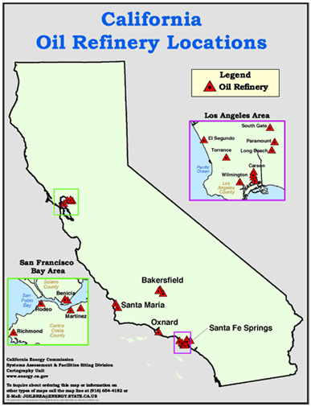
Key Elements - Refineries
  12 refineries produce transportation fuels that meet California standards
    42.4 million gallons per day gasoline
    10.2 million gallons per day diesel fuel
    10.6 million gallons per day jet fuel
  8 smaller refineries produce asphalt and other petroleum products
  Important source of transportation fuel to neighboring states
    NV 85 percent, AZ 40 percent
  Processed 1.712 million barrels per day of crude oil during 2017
California Energy Commission

Slide 9
Crude Oil - Marine Movements
  68.8 percent of crude oil transported by marine vessel in 2017
    Foreign sourced – 968.7 TBD (56.4 percent)
    Alaska sourced – 211.2 TBD (12.3 percent)
SF Bay Area refineries received 66.6 percent via marine vessel during 2017.
Foreign sourced – 430.8 TBD (57.0 percent)
Alaska sourced – 72.6 TBD (9.6 percent)
Southern California refineries received 70.4 percent via marine vessel during 2017.
Foreign sourced – 537.9 TBD (56.0 percent)
Alaska sourced – 138.5 TBD (14.4 percent)
California Energy Commission

Slide 10
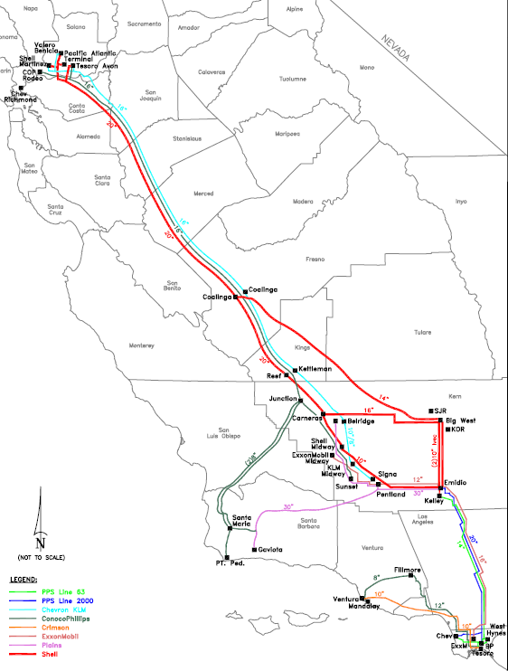
Crude Oil – California Pipelines
  31.0 percent of crude oil received by all California refineries transported via pipelines – 532.5 thousand barrels per day during 2017
    SF Bay Area refineries received 252.0 thousand barrels per day of CA crude oil via three main trunk lines from southern San Joaquin Valley – 33.4 percent of total receipts during 2017
    Southern California & Bakersfield refineries received 280.5 thousand barrels per day of CA crude via local & main trunk lines from southern San Joaquin Valley – 29.2 percent of total receipts during 2017
No crude oil pipelines into California from outside the state
California Energy Commission

Slide 11
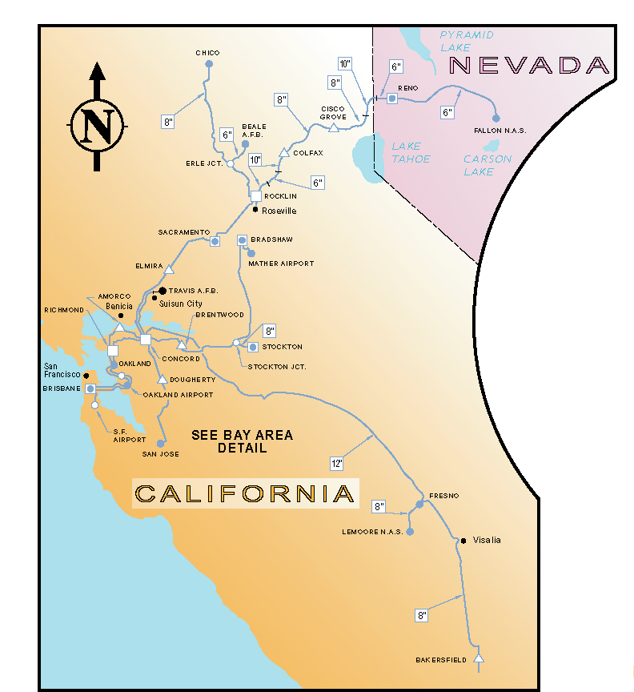
Product Pipelines – Northern California
  The pipeline infrastructure in California is controlled by a combination of common carrier and private companies
  Kinder Morgan is the primary petroleum product pipeline operator in the State and transports the majority of fuels through its system every day
  Other companies, such as Chevron, PBF, Shell, and Marathon operate proprietary systems or segments that handle the balance of transportation fuels
California Energy Commission

Slide 12
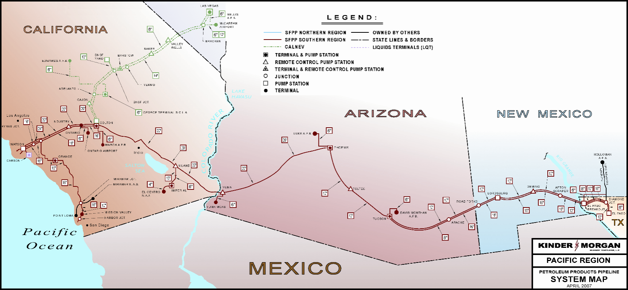
Product Pipelines – Southern California
  Southwestern system includes portions to deliver transportation fuels into Southern Nevada and Arizona
    NV – Over 85% of supply
    AZ – Over 40% of supply
  Dependency on Southern California refineries lessened by deliveries from West Texas and Utah
Pipeline systems only operate in one direction
Inability of pipeline system to operate creates two problems
Terminals begin to run out of fuel
Refineries curtail or cease operations if they are unable to send out fuel via pipeline system
California Energy Commission

Slide 13
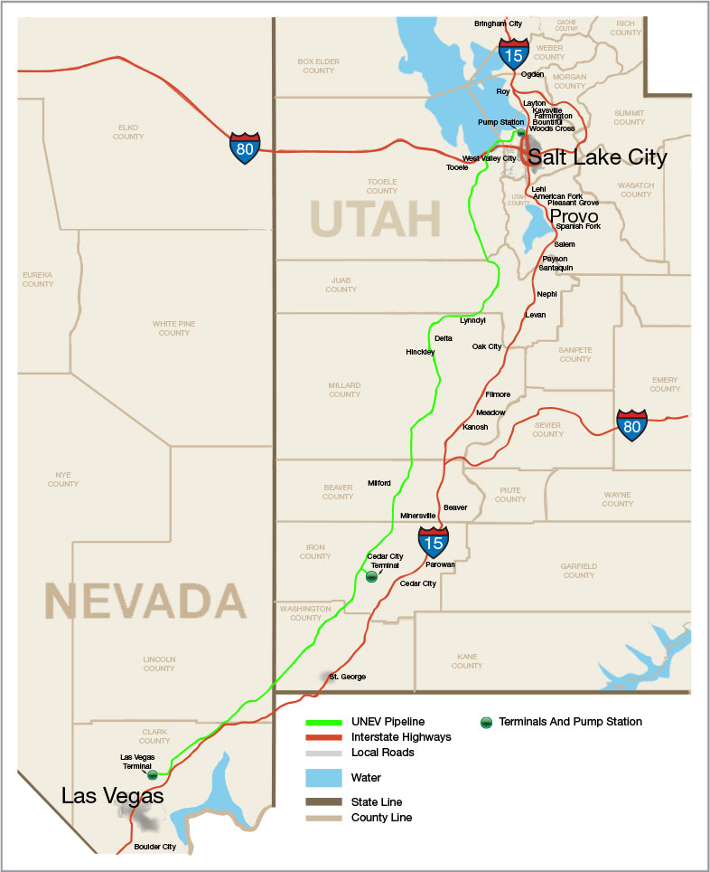
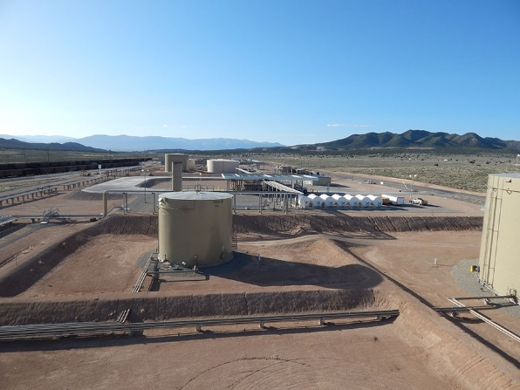
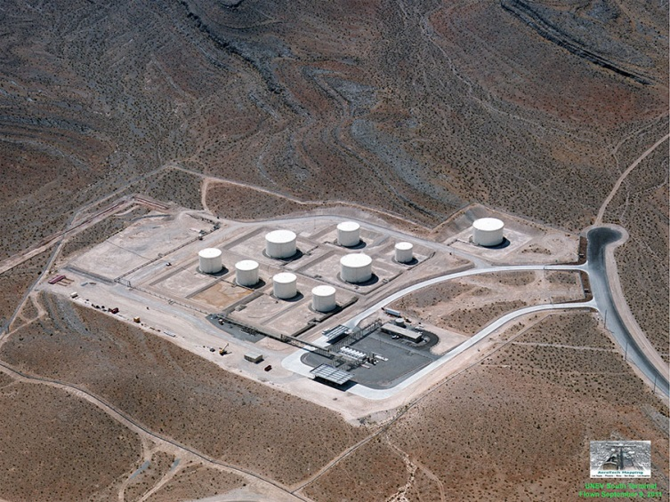
UNEV System – Utah to Las Vegas
  427-mile, 12-inch refined products pipeline – 60,000 bpd capacity
  600,000 bbls storage capacity
  Cedar City, UT
    2 truck loading bays & rail receipt
  North Las Vegas, NV
    2 truck loading bays & truck receipt
California Energy Commission

Slide 14
Marine Terminals – Imports & Exports
  California marine terminals used to send out & receive fuels
    Net exporter of diesel fuel
    Close to balanced for gasoline & blending components
    Net importer for jet fuel
  Foreign marine exports of gasoline and diesel fuel usually originate from Northern California refineries – over 90 percent
    Gasoline averaged 35.5 thousand barrels per day in 2018
      1.5 million gallons per day
    Diesel fuel averaged 43 thousand barrels per day
      1.8 million gallons per day
  Washington state refiners also export marine cargoes
    25.9 & 18.2 thousand barrels per day of gasoline & diesel in 2018
Foreign export cargoes are a potential source of emergency fuel, post catastrophic event – requires fuel and Jones Act waivers
California Energy Commission

Slide 15
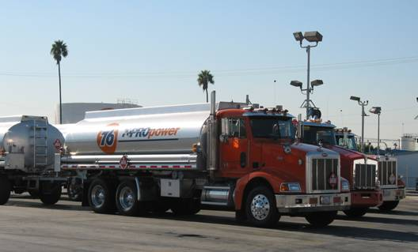
Distribution Terminals & Tanker Trucks
  Output from the refineries is usually placed in intermediate tanks prior to blending the finished products
  The majority of gasoline, diesel and jet fuel is shipped from the refinery by pipeline to over 60 distribution terminals
    25 Northern California terminals
  Tanker trucks then transport fuel to retail & non-retail stations
  Several truck trips during 2018
    Gasoline – 42.4 MM gal/day
      5,300 tanker deliveries/day
    Diesel fuel – 10.2 MM gal/day
      1,280 tanker deliveries/day
Insufficient number of tanker trucks and driving time to obtain sufficient quantities of fuel from Texas refineries
California Energy Commission

Slide 16
Interdependencies
  Most California refineries have cogeneration capability
  But depend on other outside services to sustain operations
    Source water for process steam
    Wastewater discharge handling requirements
    Natural gas to augment still gas fuel production
    Hydrogen from merchant producers to enable operations of desulphurization processing equipment
    Acid deliveries for operation of alkylation facilities
  Retail fuel stations provide majority of gasoline and diesel fuel to the public
  Retail stations need electricity to operate dispensers
  Even with back-up power, stations need telecommunication capability to process transactions
California Energy Commission

Slide 17
CEC’s Role for Emergency Fuel
California Energy Commission

Slide 18
California Emergency Fuel Supplies
  The Energy Commission does not own any emergency fuel supply
  Rather, the California Energy Commission (CEC) has the authority to hold inventories & redirect refined product supplies from private-sector refineries & distribution terminals when the Fuels Set-Aside Program (FSAP) is triggered
  CEC works in coordination with the California Office of Emergency Services (OES) and key partners to: identify private-sector sources of fuel & communicate with industry on what portion of their inventory must be held to be used for emergency response and critical functions fuel-related mission tasks
  Liquid transportation fuels, not electricity or natural gas
    Gasoline, diesel fuel, Jet A, aviation gasoline & propane
FSAP is not designed nor intended to provide adequate supplies of transportation fuels for all end-users, including the public, following a catastrophic loss of local refinery production & distribution operations.
California Energy Commission

Slide 19
CEC Emergency Response Role:
Transportation Fuel Supplies
The Office of Emergency Services (CalOES) is the lead State agency in an emergency
CEC Role is outlined in the Energy Commission’s Emergency Plan:
https://www.energy.ca.gov/emergencies/
How is the Fuels Set-aside Program (FSAP) triggered?
  Governor declares a state of emergency
  Chair of the Energy Commission recommends activation of the FSAP based on severity of impact to transportation fuel supplies
  Governor issues Emergency Order, empowering the Energy Commission to hold control of and redirect petroleum stocks needed to ensure the health, safety and welfare of the public
To date no emergency declaration in the state has necessitated that the FSAP be triggered on a formal basis – what type of event could?
California Energy Commission

Slide 20
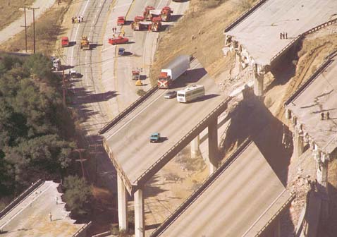
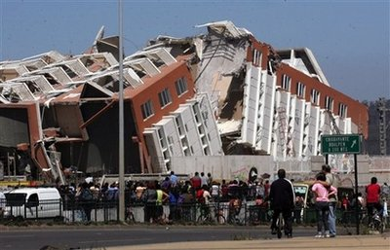
Catastrophic Earthquake
  Unprecedented event - not experienced in our lifetimes
  Business-as-usual will not suffice
  Large portion of fuel supply will be lost or unavailable
  Demand outside the impacted region will experience varying degrees of panic-buying
  There will be a fuel shortage for California & Northern Nevada
California Energy Commission

Slide 21
FSAP – Function
Prioritize and support the goals and objectives set by the Unified Coordination Group
California Energy Commission Responsibilities
  Transportation fuel supply situational awareness
  Supporting emergency fuel mission requests
  Mission approvals in context of scarce resources/capabilities
CEC personnel stationed at the SOC supporting Emergency Response
  Reporting on locations where fuel is available
  Reporting on status of refineries & petroleum pipelines
    Return to service estimates
    Interdependencies that are preventing restart
      Water, natural gas, hydrogen or electricity
  Waiver recommendations
    Increasing fuel supplies, reducing logistic delays & demand reduction
CEC personnel stationed at the Energy Commission
  Obtaining accurate and timely information from industry
    Inventory levels by fuel type & location
  Communicating with industry stakeholders
California Energy Commission

Slide 22
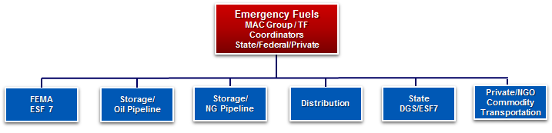
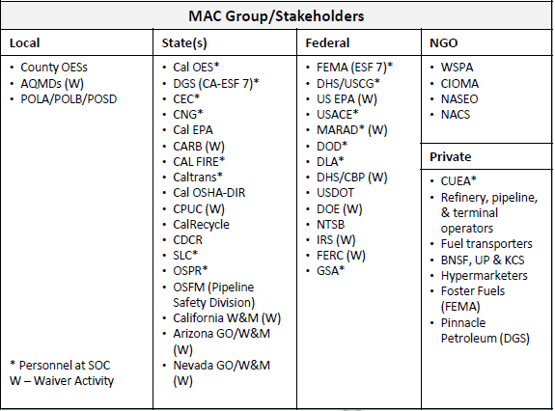
Emergency Fuels Coordination
Emergency Preparedness & Planning Activities
Identify potential Emergency Fuels stakeholders for a Multi Agency Coordination Group or Task Force
Work with stakeholders to identify roles and responsibilities
Work with stakeholders to identify key issues and potential solutions
* Example MAC Group/TF Stakeholders
California Energy Commission

Slide 23
Waivers
California Energy Commission

Slide 24
Purpose of Waivers
  There will not be sufficient transportation fuel supplies to meet normal demand following a catastrophic earthquake
    Steps will need to be undertaken to increase fuel supply & decrease demand
  Waivers will provide an ability to maximize alternative sources of transportation fuel supplies and minimize timelines to deliver to emergency-related activities is contingent on the rapid approval of a variety of fuel specification, logistics, and emission limit waivers from federal, state, and local entities
Not all waiver processes have been previously utilized
Some waiver processes & participants need to be verified
California Energy Commission

Slide 25
Fuel Waivers
  Purpose - intended to waive certain specifications that would enable the use of any type of gasoline, diesel fuel or aviation fuels in the aftermath of a catastrophic event. Maximize alternative sources of transportation fuels, regardless of local or regional specification requirements.
    California fuel specifications (CA reformulated gasoline and CA ultra-low sulfur diesel fuel)
    Arizona and Nevada fuel specifications (state specific gasoline standards unique to the region)
    Federal fuel specifications (federal reformulated gasoline & federal ultra-low sulfur diesel fuel)
    Gasoline Rvp limits (allow switch from summer to winter recipe)
    Red dye diesel use (allow tax exempt diesel to be used in on-road application)
Responsible entities – CARB, US EPA, DOE (EIA), AZ & NV W&M, AQMDs and IRS
California Energy Commission

Slide 26
Logistics Waivers
  Purpose - intended to waive certain restrictions to increase availability of fuel transportation assets (marine tankers, rail tank cars, and tanker trucks) and decrease delivery timelines.
    Jones Act (allow foreign-flagged marine tankers to transport fuel)
    Truck weight limits (allow heavier-than-permitted loads of fuel to be transported)
    Driver hour limitations (allow truck drivers to operate for longer periods)
    Pipeline product codes (allow other types of fuel to be dispensed through petroleum product pipeline systems)
Responsible entities – DHS, DOE, MarAD, DoD, CHP, FERC and CPUC
California Energy Commission

Slide 27
Emission Limit Waivers
  Purpose - intended to waive certain restrictions of equipment to enable operations that could exceed maximum allowable emissions in excess of existing permit limits.
    Emergency generator operational limits (allow back-up generation sets to operate continuously until electrical service is restored)
    Floating roof fuel storage tanks (allow tank levels to decrease lower than normally permitted)
    Vapor recovery limits related to fuel transfer operations (allow equipment to exceed permit limits)
Responsible entities – CARB, and AQMDs
California Energy Commission

Slide 28
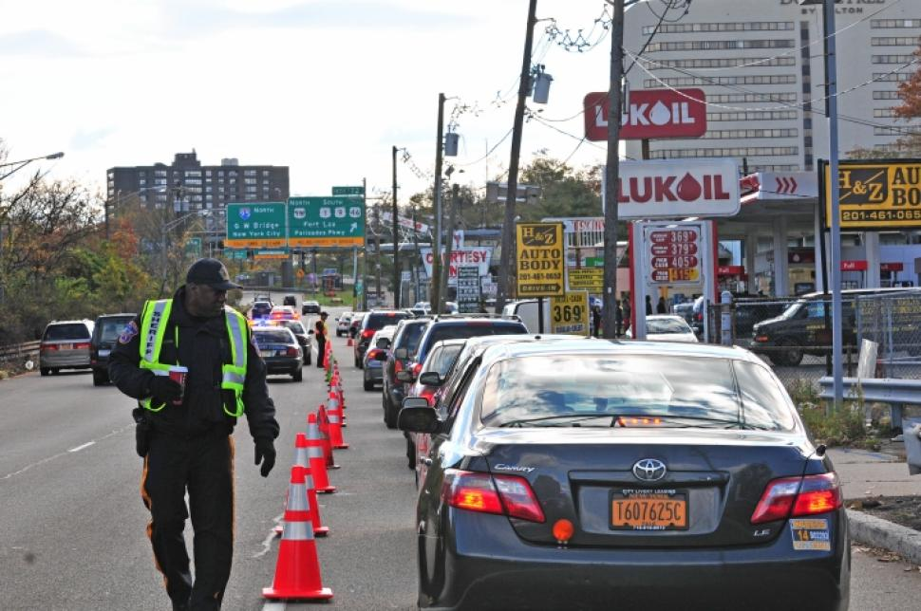
Decreased Fuel Demand Activities
  Purpose - intended to diminish hyper-demand and hoarding of transportation fuels in the aftermath of a catastrophic event of sufficient consequence to necessitate activation of the Fuel Set Aside Program.
    Odd-even rationing (limit the ability for acquisitions of non-emergency related transportation fuel to every other day)
Responsible entities – Governor’s offices in CA, AZ, & NV and law enforcement
Optimal implementation of odd-even rationing not yet determined
Enforcement difficult for most retail locations that no longer have attendants
Multiple strategies required to disseminate aspects to consumers & businesses
Plate inspection in odd-even line – Photo Credit: Norman Lono, NY Daily News
California Energy Commission

Slide 29
Transportation Fuels Working Group
California Energy Commission

Slide 30
Transportation Fuels Working Group
  A Fuels Working Group has been created at state level to improve preparedness for response to a catastrophic event
    OES, Cal NG, CUEA, DGS & CEC core members
    Participation from FEMA, Cal EPA & DLA
  Purpose
    Identify specific goals and work solutions
  Areas of focus
    Quantify fuel demand & geographic scope for emergency needs
    Alternative sources of fuel for National Guard activities
    Strategies for maximizing fuel delivery from outside California
      Rail, marine & aviation resupply
    Fuel supply inside impacted zones
      Trapped first responders still need fuel
      Local Operating Areas (OAs) can control & extend period of fuel self-sufficiency
California Energy Commission

Slide 31
Areas of Focus – Replacement Fuel
California Energy Commission

Slide 32
Fuels - Problem to be Solved
Southern California Catastrophic Earthquake Plan Update scenario - primary source of transportation fuels (local refineries) has been lost for southern California, southern Nevada and Arizona. Loss of local supply will persist for at least weeks to possibly several months.
Insufficient number of tanker trucks & driving time to replace lost supply from refineries in Texas
Aerial tanker defueling – infeasible source for commercial airport replacement fuels
  Near-term key strategy for emergency aviation fuel at designated air-bridge hubs
Marine resupply – less fuel volume available & potentially longer transit times
  Near-term source of emergency response fuel from diverted export tankers
Rail & transloading key Course of Action for obtaining substantial replacement fuels from outside area
  Local delivery tanker trucks re-directed to temporary transloading hubs as they are established
Undamaged distribution terminals – initial source for emergency response fuels
  Primary sourcing likely from Northern California - Fresno closest location
27.6 million gals gasoline, 7.7 million gals jet fuel and 8.1 million gals diesel fuel daily production lost.
Fuel supply shortages in SW U.S. likely in first couple of days; insufficient fuel available to meet normal business & private activity.
Fuel for emergency response & critical needs will be priority.
California Energy Commission

Slide 33
Replacement Fuel – Outside Impacted Area
Northern CA & WA refineries via barge & marine tanker – days
  Marine barge availability could be limited
  Marine terminals ability to receive could be compromised
  Foreign cargoes leaving region by marine tanker could be diverted to impacted region – requires federal and state waivers
  Typical product tanker holds 12 million gallons of gasoline or diesel fuel
US Gulf Coast refineries via rail tank car – days to weeks
  Rail transloading enables use of local fuel transportation trucks
  Locations TBD
  Security
  Transload crews
  Supply sources TBD
Foreign refineries via marine tankers – 3 weeks+
  Longer-term resupply option
  Requires ability to receive at marine terminal
  Supply source could be sustained long-term
California Energy Commission

Slide 34
Replacement Fuel – Inside Impacted Area
State, county, and municipal fuel storage locations/yards
  CalTrans & other state yards that store fuel
  City /county fuel storage sites
  Ability to dispense fuel may be hindered by lack of power
  Ability to access fuel from storage tanks may be limited
Local distribution terminals
  Possible from locations without power or telcom
  Alternative means of safe tanker truck loading TBD
Retail stations – access “trapped” fuel
  Increases likelihood of immediate access to emergency fuel, post event – for emergency response & critical needs determined by OA
  Can provide buffer until additional fuel begins to arrive from outside the impacted region
  Various access options
    Pre-wired with transfer switches to receive portable generation and operate entire site
    Extract fuel from UST without power – requires specialized vehicle/equipment – can fuel vehicles at that location or transport to another more secure, higher priority site
  Large retail locations, such as hypermarts, can also be used as PODs
California Energy Commission

Slide 35
Urban Gas Stations – Average Sales
Should consider focusing efforts on stations with greatest throughput, storage tank capacity and dispensers - hypermarts
California Energy Commission

Slide 36
Areas of Focus – Quantify Fuel Demand
California Energy Commission

Slide 37
Operating Areas – Quantify Fuel Need
  Operating Areas (OAs) Fuel Needs
    Survivor movement
    Mass care & shelter
    Other response activities
      Fire, police & ambulance response
      Search & rescue operations
      Utility response convoy ingress and sustained operations
      Lifeline route clearance
      Critical commodity goods movement
      Other back-up generation needs
        Telecommunications
        Water & wastewater facilities
        Pipeline pump stations
        Undamaged distribution terminals
  Emergency fuel responses initiated within 24 to 48 hours – but could take between 10 to 14 days to meet & sustain all emergency & critical response fuel needs
Quantifying anticipated fuel needs in advance crucial to increasing likelihood of gaining access to sufficient supplies post event
Anticipated CUEA member fuel needs
California Energy Commission

Slide 38
CUEA-Related Fuel Needs – Logistics
Response convoy vehicles will require sufficient fuel to gain access to & maintain operations within impacted areas
  Fuel deliveries to staging areas
  In-vehicle fuel deliveries outside staging areas
Back-up generation – telecommunication sites
  Fuel deliveries require specialized trucks & remote access
  Mixture of fuels – propane & diesel fuel
  Lengthier delivery times
Back-up generation – petroleum pipeline pump stations & distribution terminals
  These facilities do not normally have on-site back-up generation capability sufficient to maintain normal operations
  Would require sufficiently sized portable back-up generation
  Pre-wiring & load capacity should be determined in advance of a catastrophic event
These types of emergency & critical response activity fuel needs could be potential candidates for pre-scripted missions
California Energy Commission

Slide 39
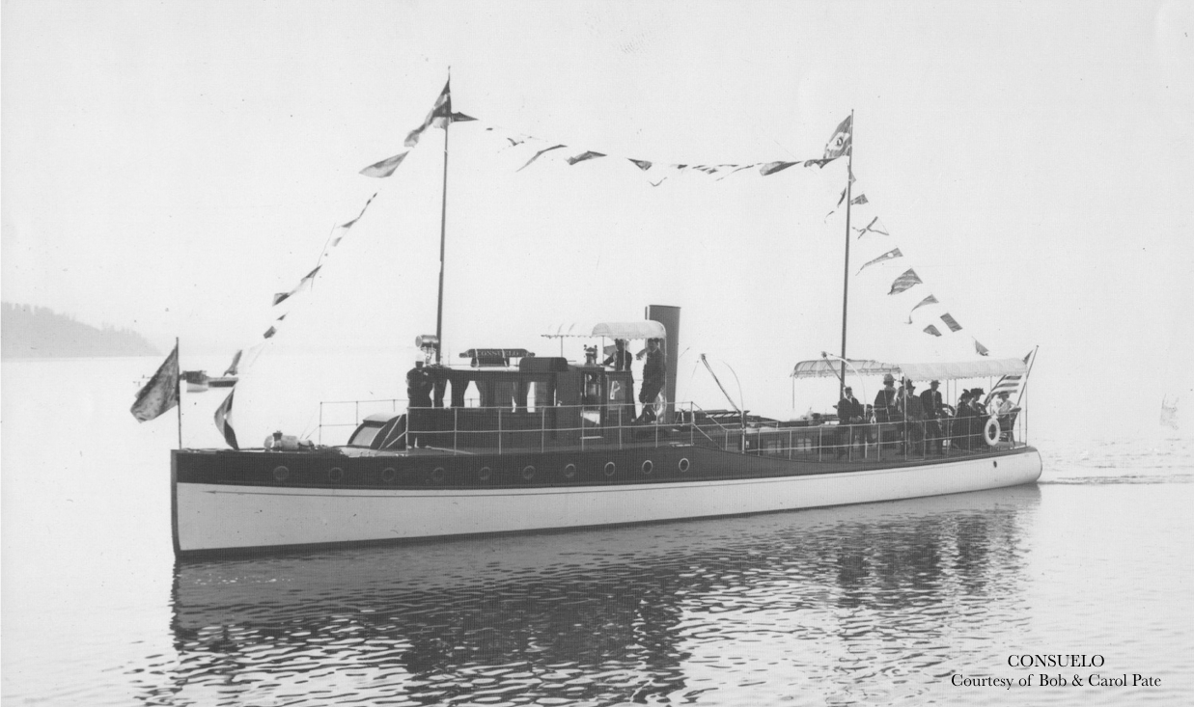
Additional Questions?
Touring yacht Consuelo, Lake Tahoe. Photo circa 1913, source Tahoehistory.info.
California Energy Commission

